Slide 1

DealTracker
— Interim Project Presentation 2
https://github.com/buChloeCLY/CS501-Project-DealTracker
Team: Leyan Chen, Yijia Chen, Juling Fan

Slide 2
Live demo

Slide 3
Working Division
Leyan Chen
Yijia Chen
Juling Fan
Sensor
External API
Database
UI and backends to each part

Slide 4
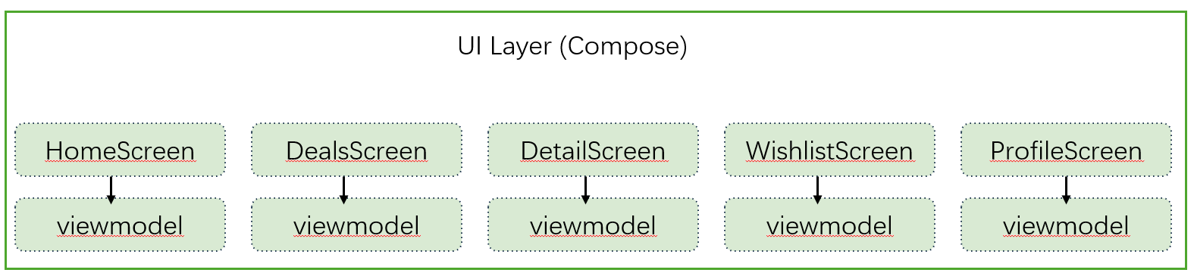
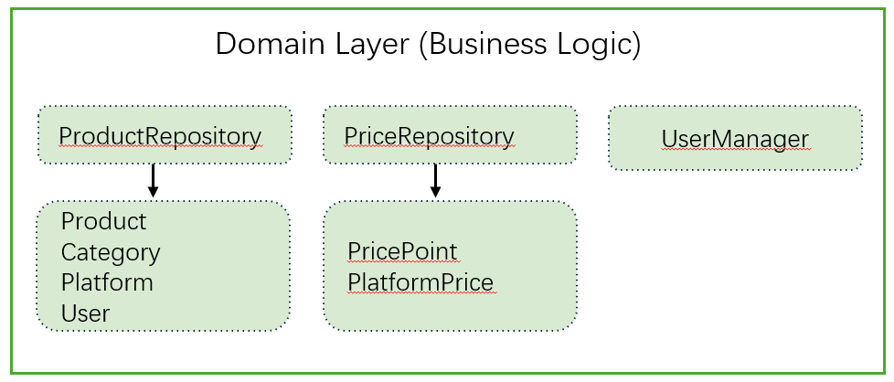
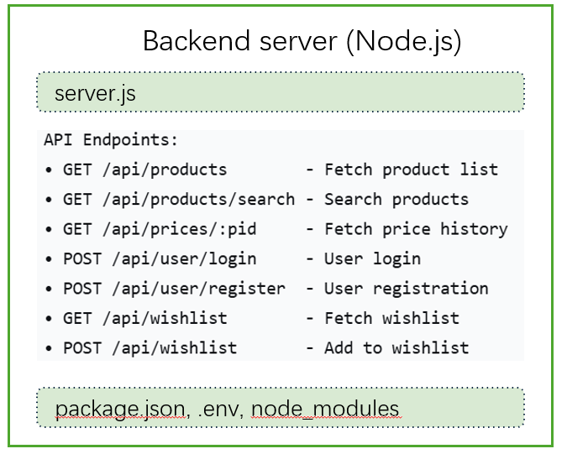
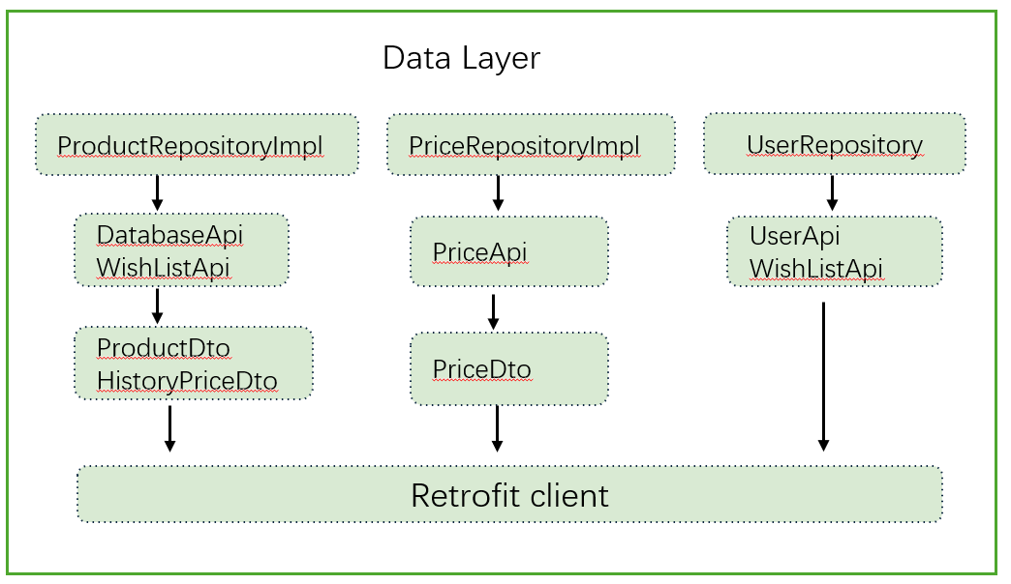
MVVM Architecture Diagram
Android APP (Jetpack Compose)

Slide 5
Dependency diagram & Data flow
UI (Compose Screens)
User browses Home page (categories, deals, search)
StateFlow
Domain Layer (Repository Interfaces: ProductRepository, PriceRepository)
Data Layer (Repositories Impl)
Remote APIs (DatabaseApiService, PriceApi, UserApi)
Backend (Node.js server)

Slide 6
Navigate flow
View one product
Price chart
Go to search
HomeScreen
DealScreen
ProductScreen
Back to home
Back to Deals
sort
Platform link
category
recommendation
View list
filter
Setting
View List
WishlistScreen
ProfileScreen
History
View list
Edit
Log in
Sign up

Slide 7
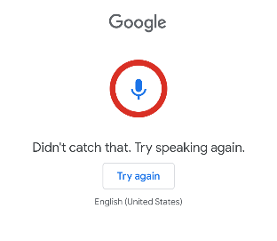
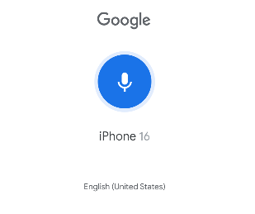
Sensor
Implemented with Android RecognizerIntent + ActivityResultLauncher
Result stored in HomeViewModel (applyVoiceResult)
Handles errors and crashes:
  Device without speech recognition
  Empty voice result
  Recognition canceled or failed
Testing / Debugging:
  Checked normal flow, empty input, cancel, and unsupported device
  Error messages displayed via voiceError StateFlow

Slide 8
API
User Management
Price & history APIs
Product management
import-initial
Wishlist APIs
Admin / maintenance APIs
update-all-prices
sync-lowest-prices
Scheduled job
System / test endpoints

Slide 9
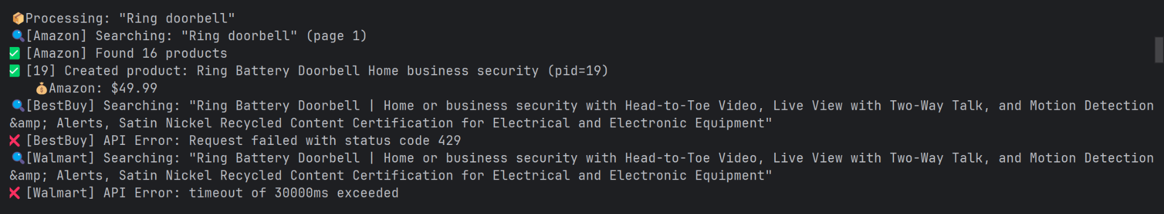
Testing & debugging
I first added log statements in the code and inspected the backend server logs.

Slide 10
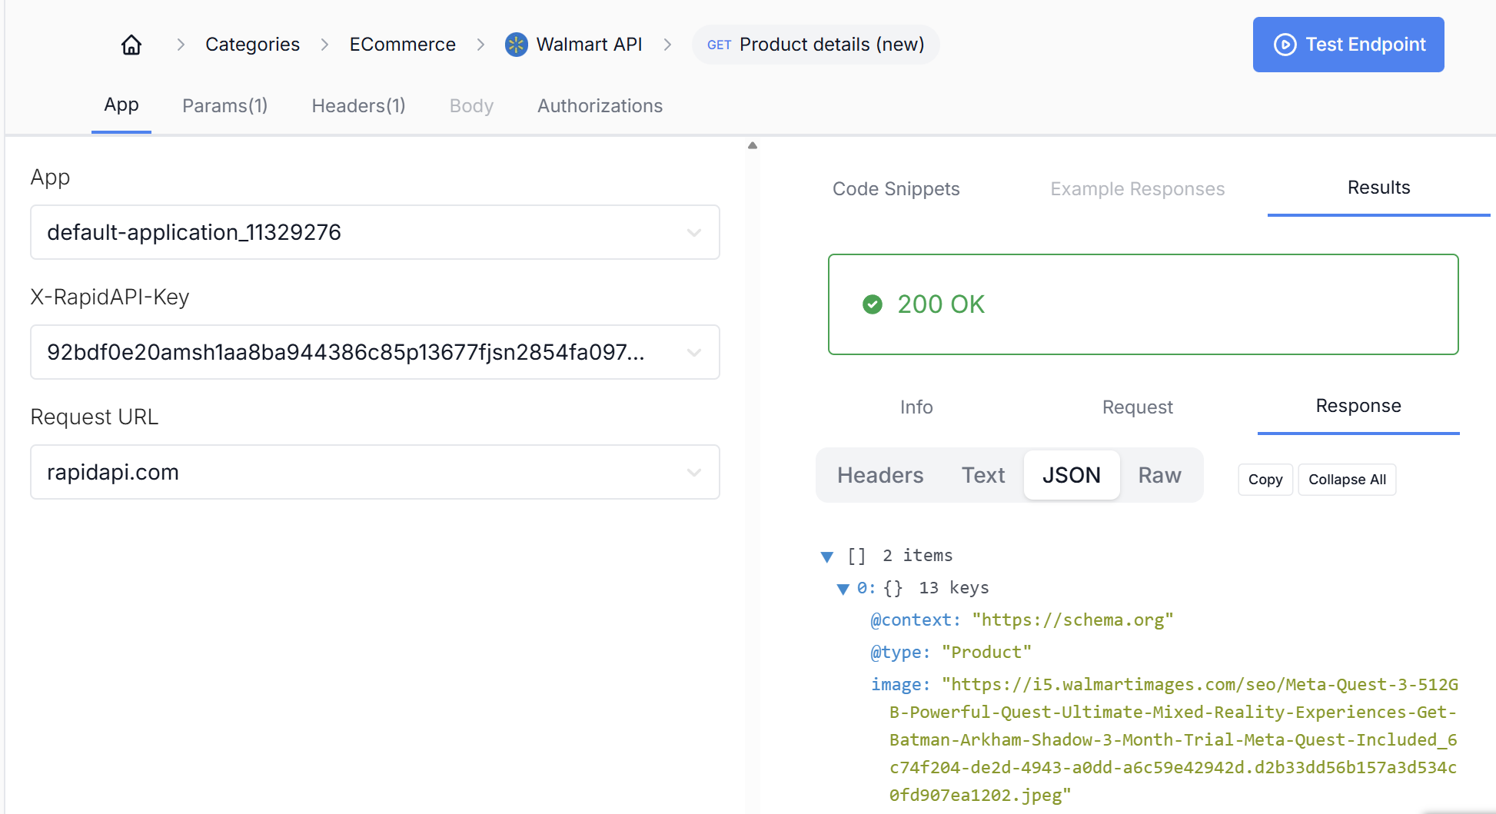
Testing & debugging
Then I used the RapidAPI console and Postman to manually test each endpoint to confirm that the backend was parsing and returning fields correctly.
Conclusion:
HTTP status code 429: API has reached the free request limit and the service stops responding;
Timeout error: The API is too slow, in which case we should consider removing the timeout limit.

Slide 11
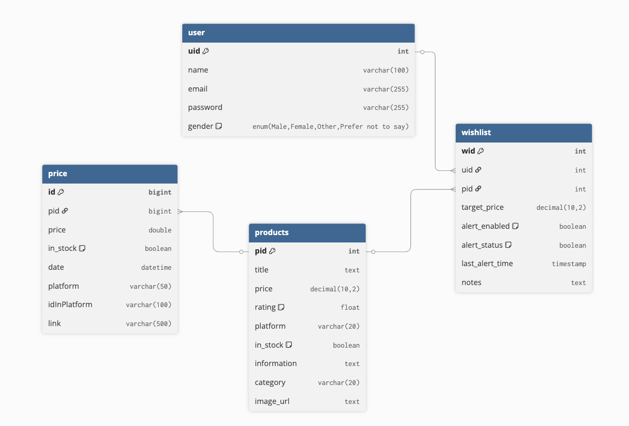
Persistence
Database: AWS-aurora (MySQL)

Slide 12
Obstacles
Search logic
  search strategy: exact matching for ensure accuracy, or fuzzy matching for better user experience.
  search results: return all results at once, or support pagination and real-time filtering.
specify same products between different platforms
Api has quota
Conflicts of our commits

Slide 13
Progress we’ve made:
Basic MVVM & workflow: ✅
Multi-platform price integration & compare : ✅ More platforms will be added in future.
Daily scheduled multi-platform update: ✅ Automatically sync the products table to the newest lowest prices every day.
Smarter product modeling: ✅ (A new function to generate concise, user-friendly titles)
Richer admin workflows ✅
Wishlist support for our app ✅
Sensor (microphone) : ✅
Account management (register & login): ✅
Data persistence : ✅
Product search & price alert: In progress…
AI recommendation : ❌
Stretch goals adjustment
Social Sharing: In progress…
Smart Coupon Integration: ❌

Slide 14
Thanks for Listening

